Slide 1
Recommender System for Devotional Music App
Team 4
Mr. Milind Malhari Takate
Mr. Aniket Anil Sharma
Mr. Yeggoni Manoj Kumar
Mr. Saket sham Khatavkar
Mr. Vaibhav Prakash
Miss. Anagha Pradeep

Slide 2
Table of contents
01
02
03
04
Introduction to Recommender System
Data collection
Extracting dataset from Kaggle
Why recommender? & examples
EDA
Final outcome
Performing initial investigation on data
Model deployment

Slide 3
Introduction
Recommendation is an information filtering technique, which provides users with information, which he/she may be interested in. With advancement in the technologies, recommendation systems are becoming more & more popular and necessary.
This project intends to develop a recommendation feature for an application in order to improve the user experience.

Slide 4
Problem Statement
The aim of this project is to build a feature of recommendation system to support a music app. As the first phase we need to develop the proof of concept to make the client understand how effective the feature could be.

Slide 5
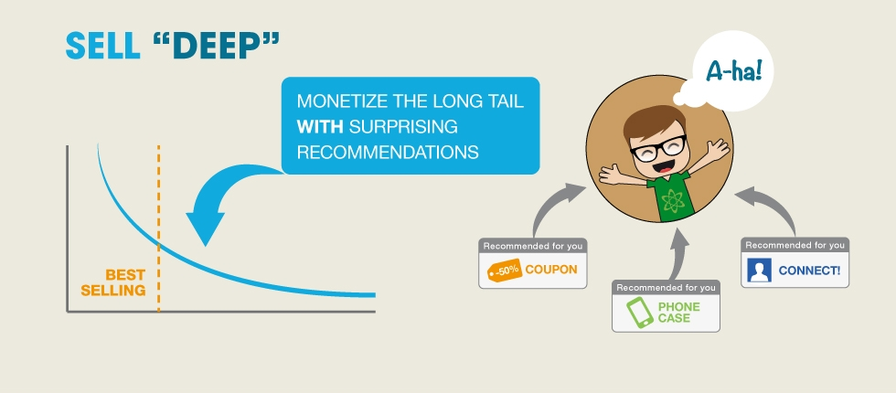
Why Recommender?
“We are living in the age of information and entering the age of recommendation.”
—— Chris Anderson in “The Long Tail”

Slide 6
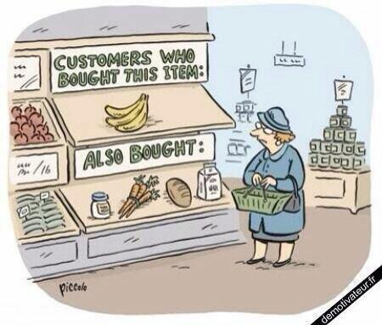
The Age of Recommendation
Search:
User Items
Recommend:
Items User

Slide 7
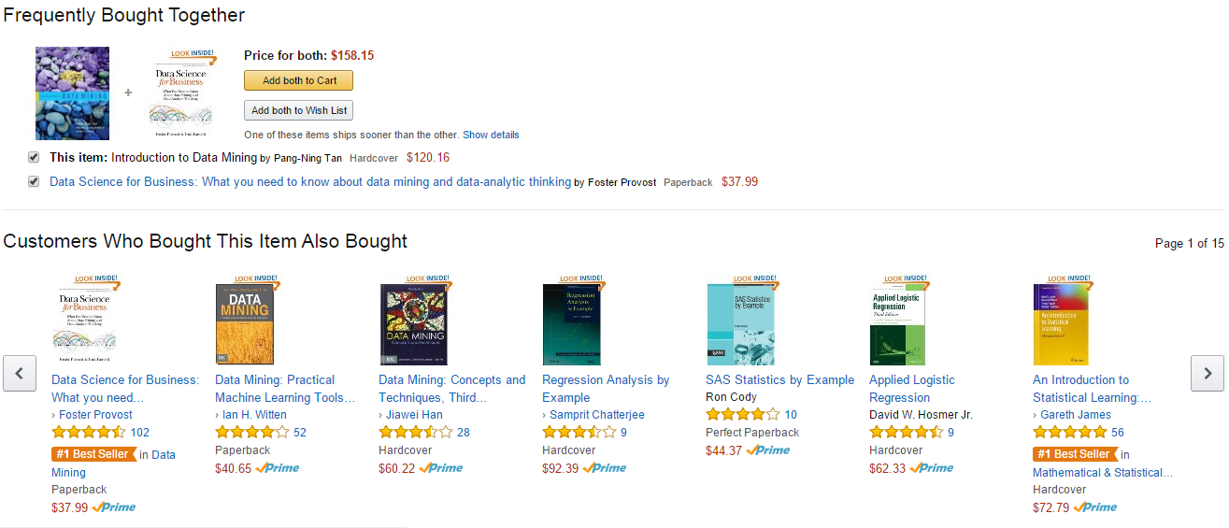
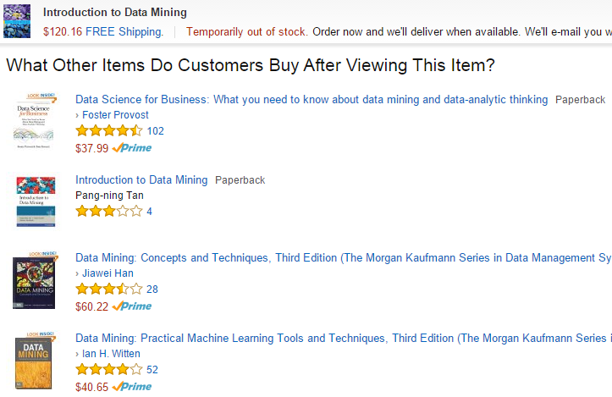
Amazon: A personalized online store

Slide 8

Google YouTube Recommendation System
Why:
Focus on videos, bring videos to users which they believe users will be interest in
Increase the numbers of videos, increase the length of time, and maximize the enjoyment
Ultimately google can increase revenue by showing more ads
Interesting things:
Give up its old recommendation system based on random walk, changed to a new one based on Amazon’s item-to-item collaborative filtering in 2010
Amazon’s item-to-item collaborative filtering appears to be the best for video recommendation

Slide 9
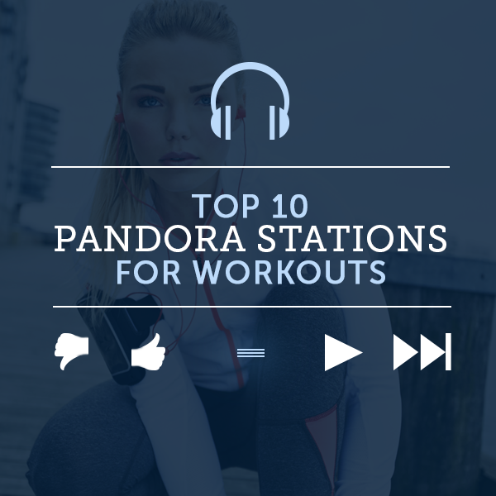
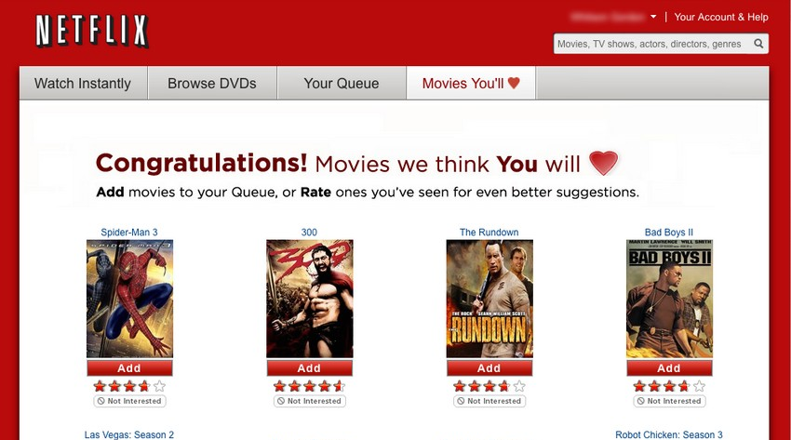

Some Related Applications

Slide 10
Recommender:
A good recommender:
Shows programming titles to a software engineer and baby toys to a new mother.
Don’t recommend items user already knows or would find anyway.
Expand user’s taste without offending or annoying him/her…

Slide 11
Challenges:
Huge amounts of data, tens of millions of customers and millions of distinct catalog items.
Results are required to be returned in real time.
New customers have limited information.
Old customers can have a glut of information.
Customer data is volatile.

Slide 12
Traditional Recommendation Algorithms
Collaborative/Social-filtering system – aggregation of consumers’ preferences and recommendations to other users based on similarity in behavioral patterns
Content-based system – supervised machine learning used to induce a classifier to discriminate between interesting and uninteresting items for the user
Knowledge-based system – knowledge about users and products used to reason what meets the user’s requirements, using discrimination tree, decision support tools, case-based reasoning (CBR)
The one we have used is Collaborative or Social-filtering system.

Slide 13
Data collection
We have used different methods of extraction - API’s and Reportify/Sidify Music Converter to get the desired data sets for our project and source of these data sets are obtained from Kaggle and GitHub
Link: https://www.sidify.com/resources/export-spotify-playlist-to-excel-csv.html
The file being used is:
1. triplets_file.csv: Number of Rows: 1,048,576 Number of Columns: 3
Names of Columns: user_id, song_id and listen_count.

Slide 14
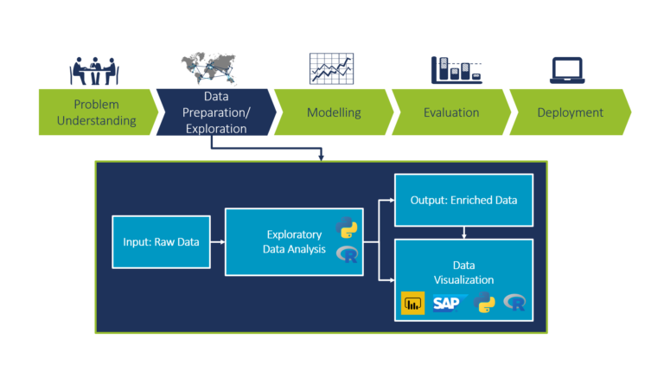
Project Flow/Project Architecture

Slide 15
EDA
1. We have 3 columns - user_id song_id and listen_count
of which the first two columns are in the form of Strings and the third one Numerical (Float).
2. Each id in the user_id represents unique user and the id in song_id represents unique songs.
This helps in building a recommendation system for any genre including devotional.
3. We have grouped data based on the songs count i.e., how many times each songs has been heard by all the users, and also grouped data based on how many songs each user has heard.
4. We have obtained data about a particular user i.e., how many songs have been heard by the user 'n' number of times

Slide 16
5. We have plotted the listen_count data.
6. We have fetched number of unique users (out of 20000) we have 1247 unique users and 8562 unique songs.
7. We then have also obtained a matrix of unique users and songs and a Pivot table that converts data into numerical matrix with listen_count as values
8. Finally we have filled the Nan values with 0

Slide 17
Further Process:
1. We have used cosine to find the distance first and then similarity between two users. In this, user_sim = 1 - pairwise_distances( user_songs_df.values,metric='cosine') - more distance less similarity and vice versa
2. Similar listen count will give values as 1 and same user id angle will give 0
3. While calculating between 2 user so not keeping diagonal as 1

Slide 18
4. Converting matrix into data frame user_sim_df = pd.DataFrame(user_sim) and describing the shape
5. user_sim_df.iloc[:5,:5] -> similarity between 2 users
6. We then set indexes with user[24] and filling diagonal with 0 -> user_sim_df
7. Sorting according to user(0007c0e74728ca9ef0fe4eb7f75732e8026a278b) and find Top 100

Slide 19
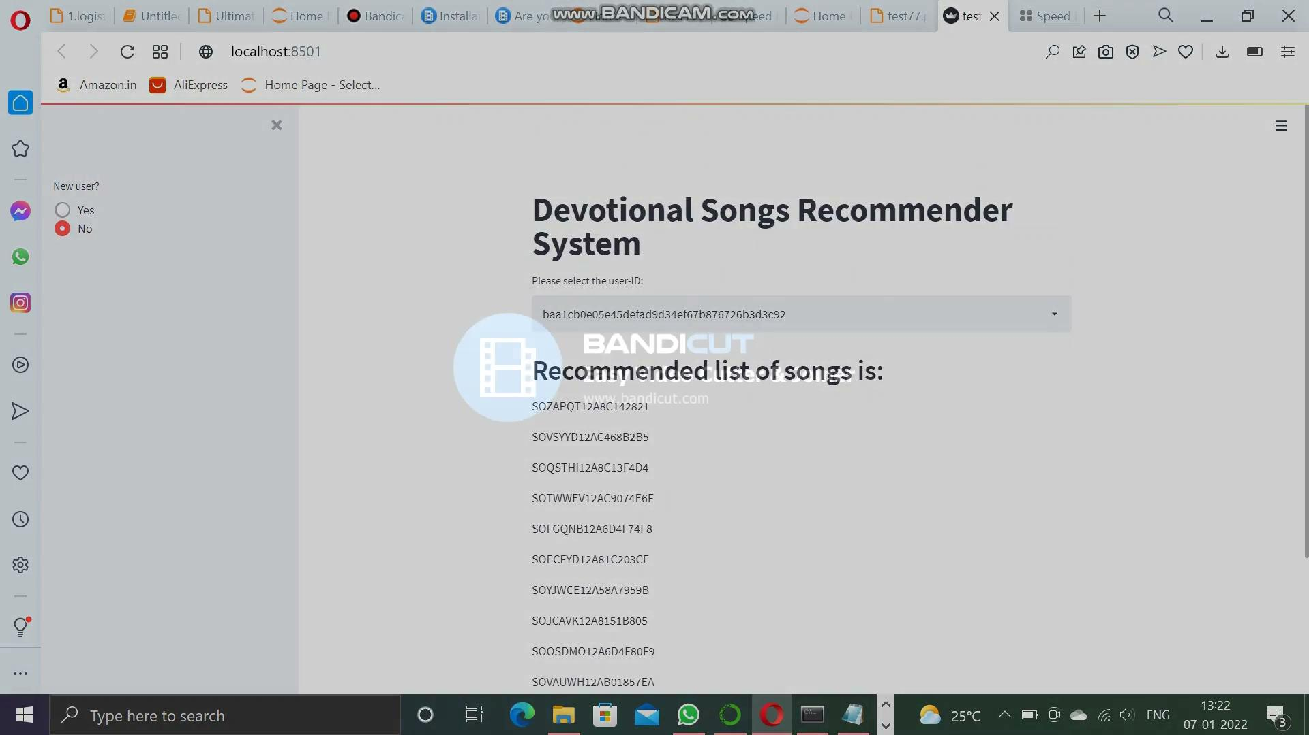
Video of the Deployed Project:

Slide 20
Thank You

